Slide 1
Genetic Algorithms
Slides are adopted from:
Chapter 27, Data Mining and Predictive Analytics, D. T. Larose, C. D. Larose, 2nd edition, Wiley, 2015
Chapter 3, Introduction to Evolutionary Computing, A. E. Eiben,‎ J. E. Smith, 2nd edition, Springer, 2015

Slide 2
Introduction
Genetic Algorithms (GAs) attempt to computationally mimic the process by which natural selection operates and apply them to solve problems
Developed by John Holland in the 60’s and 70’s
Terminology borrowed from genetics
chromosome refers to one candidate solution
gene is a single bit or digit of candidate solution
allele is an instance of bit or digit

Slide 3
Operators Used by Genetic Algorithms
Selection. Refers to the method used for selecting which chromosomes will be reproducing
A fitness function evaluates each of the chromosomes
The fitter the chromosome the more likely it will be selected to reproduce
Crossover. Performs recombination during mating, creating two new offsprings by randomly selecting a locus and exchanging subsequences to left and right of that locus between two chromosomes chosen during selection
Mutation. Randomly changes the bits or digits at a particular locus in a chromosome; however with very low probability

Slide 4
Updating a Population
GAs work by iteratively updating a collection of potential solutions called a population
Each member is evaluated for fitness on each cycle
New population replaces the old population
fittest members chosen with higher probability for reproduction
variation operators take place to produce offsprings
The fitness function f(x) is a real-valued function operating on the chromosomes

Slide 5
General Scheme of a GA
Parent selection
Parents
Intialization
Recombination
(crossover)
Population
Mutation
Termination
Offspring
Survivor selection

Slide 6
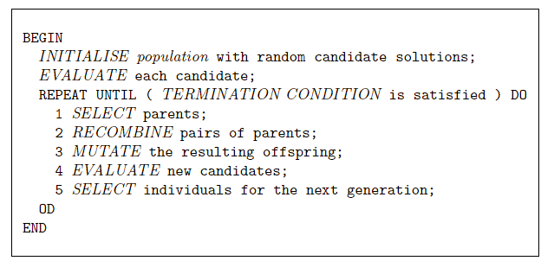
General scheme in pseudo-code

Slide 7
Main Components of GA
Representation
Fitness function
Population
Selection
Variation operators
mutation
crossover/recombination
Initialization
termination

Slide 8
Representation
Represent each individual/chromosome in a way suitable for GA
This coding allows candidate solutions to be manipulated by variation operators
Leads to two levels of existence
phenotype: object in original problem context, the outside
genotype: code to denote that object, the inside (chromosome, “digital DNA”)

Slide 9
Representation (cont.)
Two mappings:
Encoding : phenotype=> genotype
Decoding : genotype=> phenotype
Example: represent integer values by their binary code
Phenotype space
Genotype space
Encoding
(representation)
10010
18
10
2
9
1001
Decoding
(inverse representation)

Slide 10
Fitness Function (Evaluation)
Some traits are advantageous & desirable
e.g. big ears, white fur color
these traits are rewarded by more offsprings that will expectedly carry the same trait
Assigns a single real-valued fitness to each individual
which forms the basis for selection
so the more discrimination (different values) the better
Typically we talk about fitness being maximized or minimized

Slide 11
Population
A population holds the candidate solutions of the problem as individuals (genotypes)
Formally, a population is a multiset of individuals, i.e. repetitions are possible
Population is the basic unit of evolution, i.e., the population is evolving, not the individuals
Selection operators act on population level
Variation operators act on individual level

Slide 12
Population (cont.)
Selection operators usually take whole population into account
i.e., reproductive probabilities are relative to current generation
Diversity of a population refers to the number of different fitnesses / phenotypes / genotypes present

Slide 13
Selection mechanism
Identifies individuals to become parents & to survive
Pushes population towards higher fitness
Usually probabilistic
high quality individuals more likely to be selected than low quality but not guaranteed
even worst in current population has non-zero probability of being selected
This stochastic nature can aid escape from local optima

Slide 14
Selection mechanism (cont.)
Example: roulette wheel selection
fitness(A) = 3
1/6 = 17%
B
fitness(B) = 1
A
C
fitness(C) = 2
3/6 = 50%
2/6 = 33%
In principle, a different selection mechanism can be used for
parent selection as well as for survivor selection

Slide 15
Selection mechanism (cont.)
Survivor selection a.k.a. replacement
Most GAs use fixed population size so need a way of going from (parents + offspring) to next generation
Often deterministic (while parent selection is usually stochastic)
Fitness based : e.g., rank parents + offspring and take best
Age based: make as many offspring as parents and delete all parents
Sometimes a combination of stochastic and deterministic

Slide 16
Variation Operators
Purpose is to generate new candidate solutions
Usually divided into two types
crossover/recombination operators
mutation operators
There has been much debate about relative importance of recombination and mutation
Nowadays most GAs use both
Variation operators must match the given representation

Slide 17
Crossover/Recombination
Merges information from parents into offspring
Choice of what information to merge is stochastic
Most offspring may be worse, or the same as the parents
Hope is that some are better by combining elements of genotypes that lead to good traits
Principle has been used for millennia by breeders of plants and livestock

Slide 18


Crossover/Recombination (cont.)
Parents
cut
cut
1 1 1 1 1 1 1
0 0 0 0 0 0 0
1 1 1 0 0 0 0
0 0 0 1 1 1 1
Offspring

Slide 19
Mutation
Causes small, random variance in individual offsprings
Acts on one genotype and delivers another
Element of randomness is essential
Operator responsible for preserving and introducing diversity
Must preserve the given representation

Slide 20
Mutation (cont.)
1 1 1 1 1 1 1
before
after
1 1 1 0 1 1 1

Slide 21
Replacement (Survivor Selection)
Population size is constant
A decision has to be made about which individuals will be allowed in the next generation
Decision is usually based on fitness, although age may be allowed to play a role
This process is deterministic (while parent selection is stochastic process)

Slide 22
Population Initialization
Population initialisation usually done at random
Need to ensure even spread and mixture of possible allele values
Use problem-specific heuristics, to “seed” the population

Slide 23
Termination
Termination condition checked after every generation
Reaching some (known/hoped for) fitness
Reaching some maximum allowed number of generations
Reaching some minimum level of diversity
Reaching some specified number of generations without fitness improvement

Slide 24
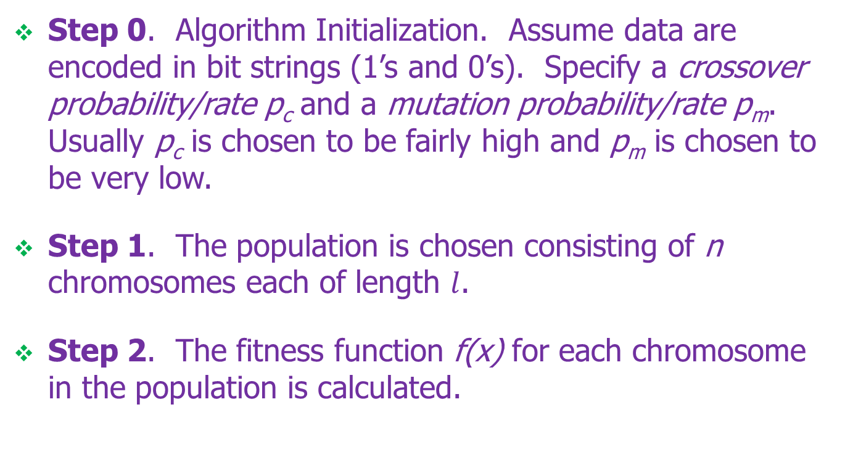
More Detailed Algorithm Basic Framework (steps 0-2)
Step 0. Algorithm Initialization. Assume data are encoded in bit strings (1’s and 0’s). Specify a crossover probability/rate p_{c} and a mutation probability/rate p_{m}. Usually p_{c} is chosen to be fairly high and p_{m} is chosen to be very low.
Step 1. The population is chosen consisting of n chromosomes each of length $l$.
Step 2. The fitness function f(x) for each chromosome in the population is calculated.

Slide 25
Basic Framework (Step 3)
Iterate through the following steps until n offspring generated:
Step 3a. Selection. Using the values from f(x), assign probability of selection to each chromosome x_{i}. -- The roulette wheel method is usually used:

Slide 26
Basic Framework (Step 3)
Step 3a. Selection (cont.). Select a pair of chromosomes to be a parent, allowing chromosomes to potentially pair with itself
Step 3b. Crossover. Select randomly chosen locust (crossover point). With probability p_{c} , perform crossover with the parents forming two new offspring or clone two exact copies of the parents.
Step 3c. Mutation. With probability p_{m} , perform mutation on each of the two offspring.

Slide 27
Basic Framework (steps 4-5)
Step 4. The new population of chromosomes replaces the current population.
Step 5. Check termination criteria. If convergence is achieved then stop and report results, otherwise go back to Step 2.
Each cycle is called a generation, with most taking from 50 – 500 generations to converge.

Slide 28
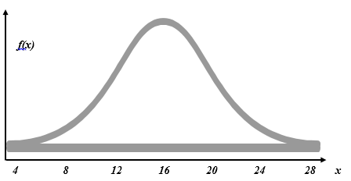
Simple Example
Suppose our task is to find the maximum value of the normal distribution, f(x), with mean μ = 16 and standard deviation σ = 4.
Allow X to take on only the values described by the first five binary digits 00000-11111 (0-31 in decimal):

Slide 29
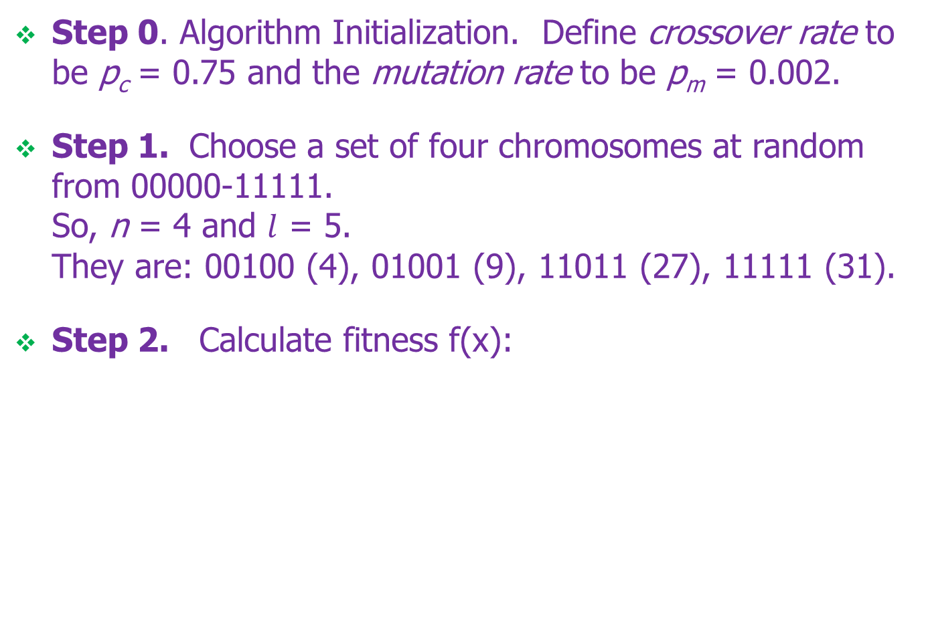
Simple Example (First Iteration)
Step 0. Algorithm Initialization. Define crossover rate to be p_{c} = 0.75 and the mutation rate to be p_{m} = 0.002.
Step 1. Choose a set of four chromosomes at random from 00000-11111. So, n = 4 and $l$ = 5. They are: 00100 (4), 01001 (9), 11011 (27), 11111 (31).
Step 2. Calculate fitness f(x):
Chromosome | Decimal Value | Fitness | Selection Probability
00100 | 4 | 0.001108 | 0.04425
01001 | 9 | 0.021569 | 0.86145
11011 | 27 | 0.002273 | 0.09078
11111 | 31 | 0.000088 | 0.00351

Slide 30
Simple Example (First Iteration)
Step 3. Iterate through the following steps until n offspring have been generated
Step 3a. Divide each f(x) by:
To get the selection probability.
Suppose 01001 and 11011 are randomly selected based on these probabilities.
Step 3b. Crossover. The locus is randomly chosen to be the second position. Suppose the large crossover rate of p_{c} leads to crossover between 01001 and 11011 occurring at the second position.

Slide 31
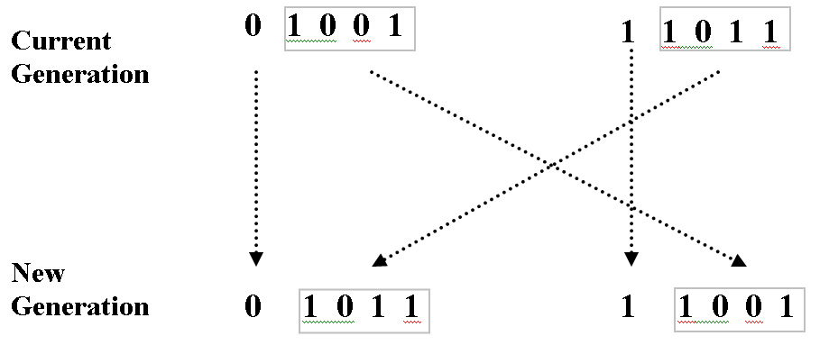
Simple Example (First Iteration)
Step 3. (cont.)
Step 3b (cont).
Step 3c. Mutation. Suppose none of the genes for 01011 or 11001 are mutated. We now have two new chromosomes in our new position. We need two more so cycle back to Step 3a.

Slide 32
Simple Example (First Iteration)
Step 3. (cont.)
Step 3a. Suppose that this time 01001 (9) and 00100 (4) are selected by the roulette wheel method.
Step 3b. This time suppose crossover does not take place. Clones become members of the new generation. We now have n =4 members in our new population.
Step 4. The new population replaces the current population.
Step 5. Iterate back to Step 2.

Slide 33
Simple Example (Second Iteration)
Step 2. fitness f(x) for each chromosome is calculated:
Step 3. The sum of the fitness values . = 0.0763
Which means the average fitness among the chromosomes in the second generation is 3 times that of the first. Selection probabilities are calculated.
Etc.
Chromosome | Decimal Value | Fitness | Selection Probability
00100 | 4 | 0.001108 | 0.014527
01001 | 9 | 0.021569 | 0.282783
01011 | 11 | 0.045662 | 0.598657
11001 | 25 | 0.007935 | 0.104033

